Slide 1
CSE299: Junior Project Design Design & Development of AGB
Faculty Initial: ITN
Semester: Summer’19
Section: 12
Group 04
Submitted By
Anwar Shadaab (1611383042)
M Saydur Rahman (1520490642)
Kazi Sadia Kabir (1420174042)

Slide 2
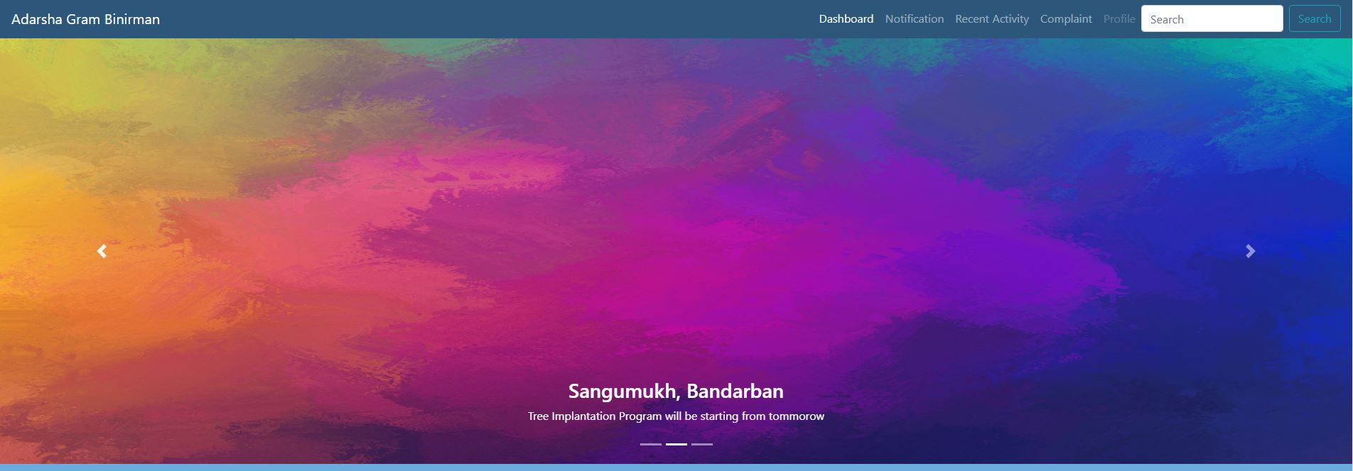
Search Bar Added

Slide 3
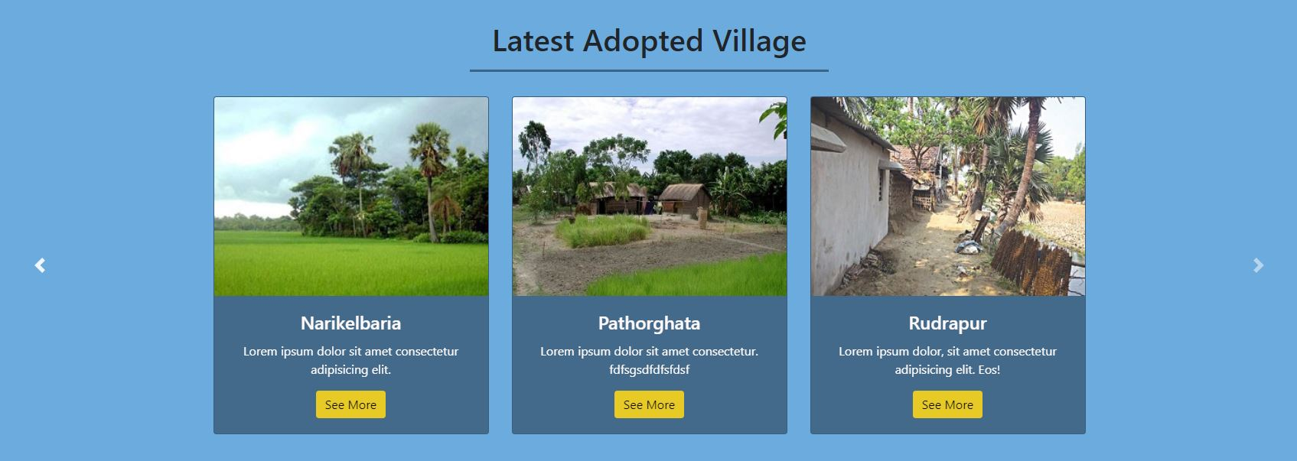
Card Slider Added

Slide 4
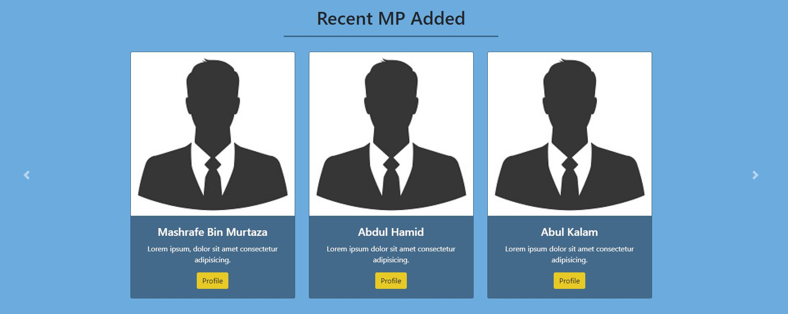
Card Slider Added

Slide 5
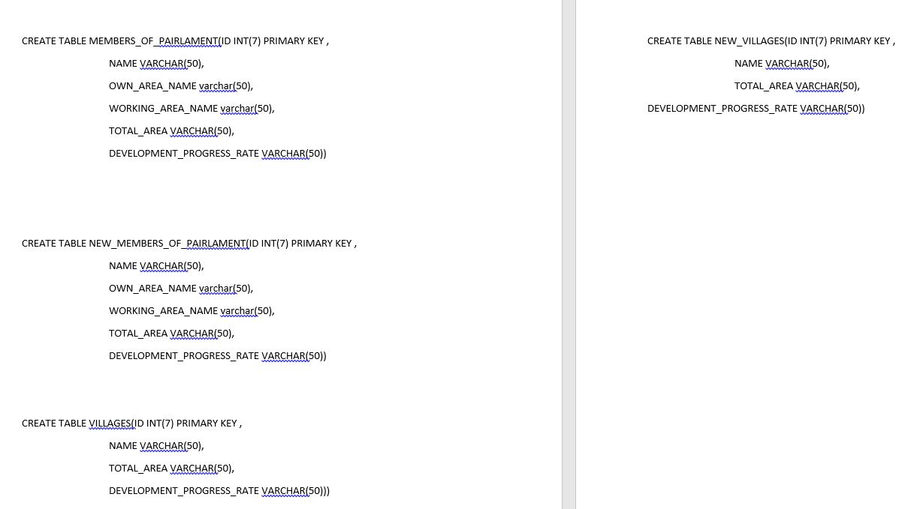
Back-End Code

Slide 6
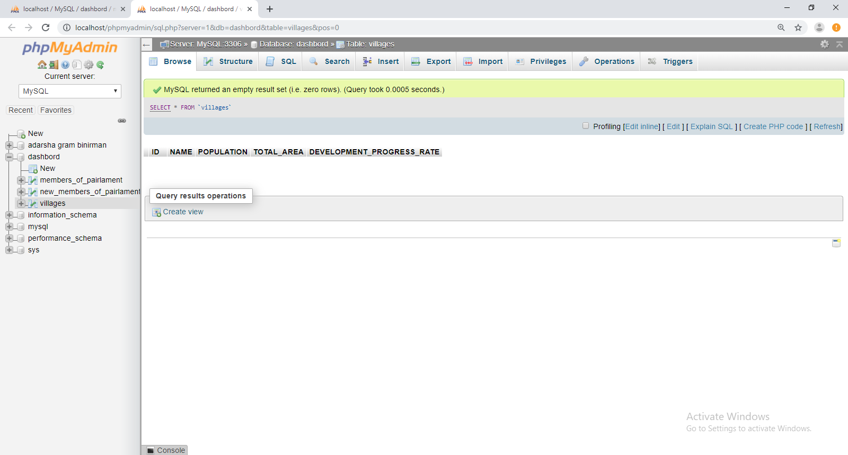
Back-End Code

Slide 7
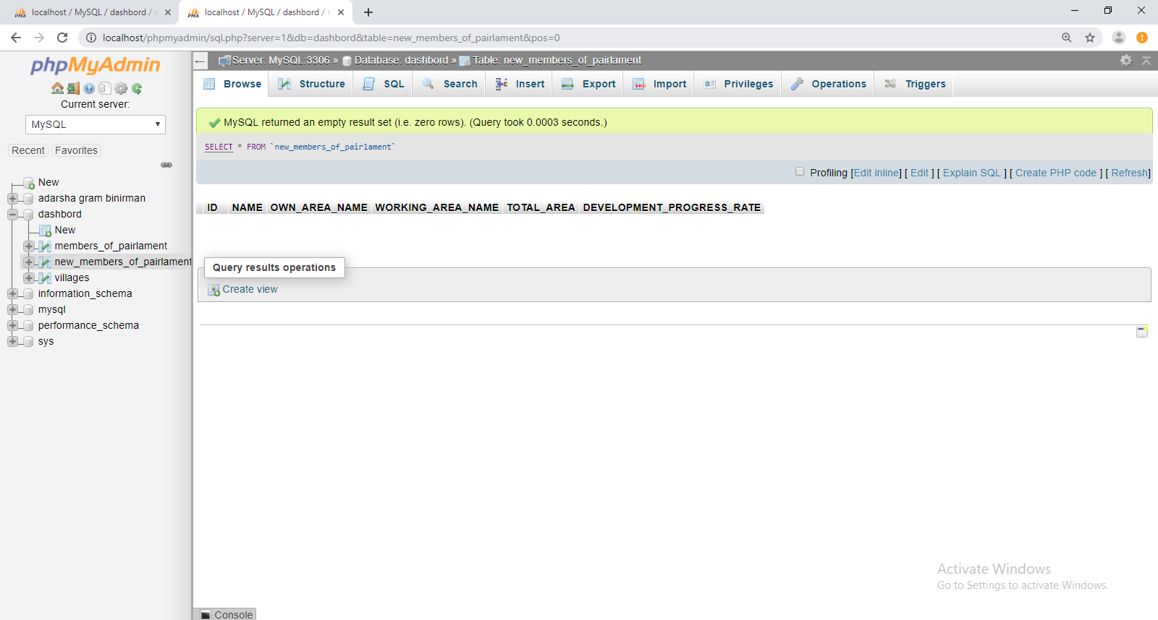
Back-End Code

Slide 8
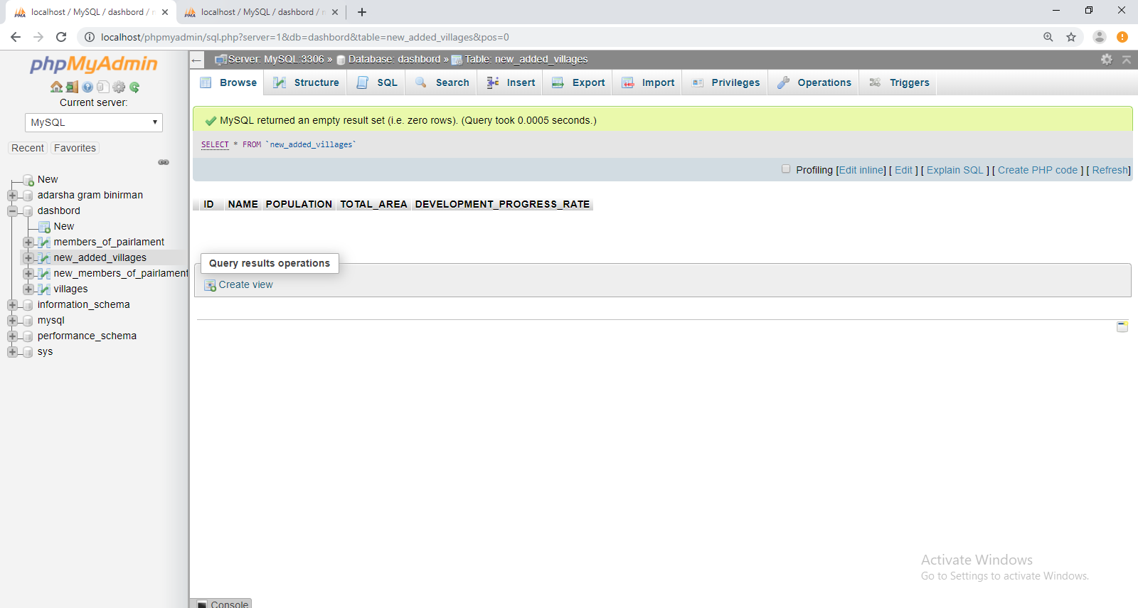
Back-End Code

Slide 9
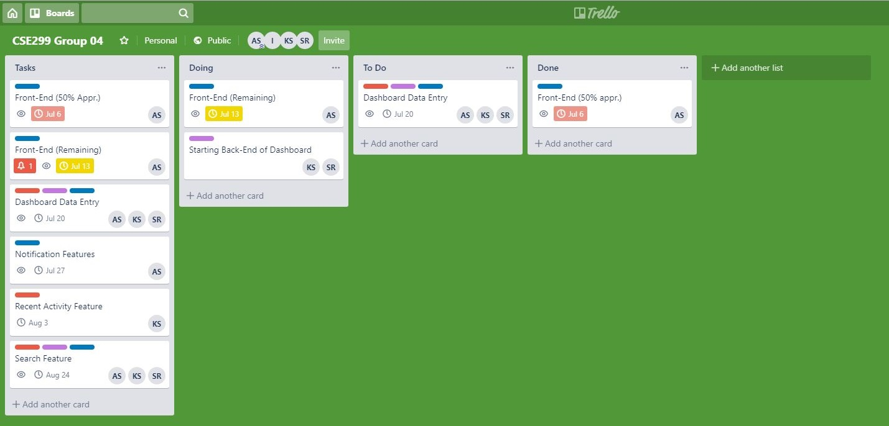
Trello

Slide 10
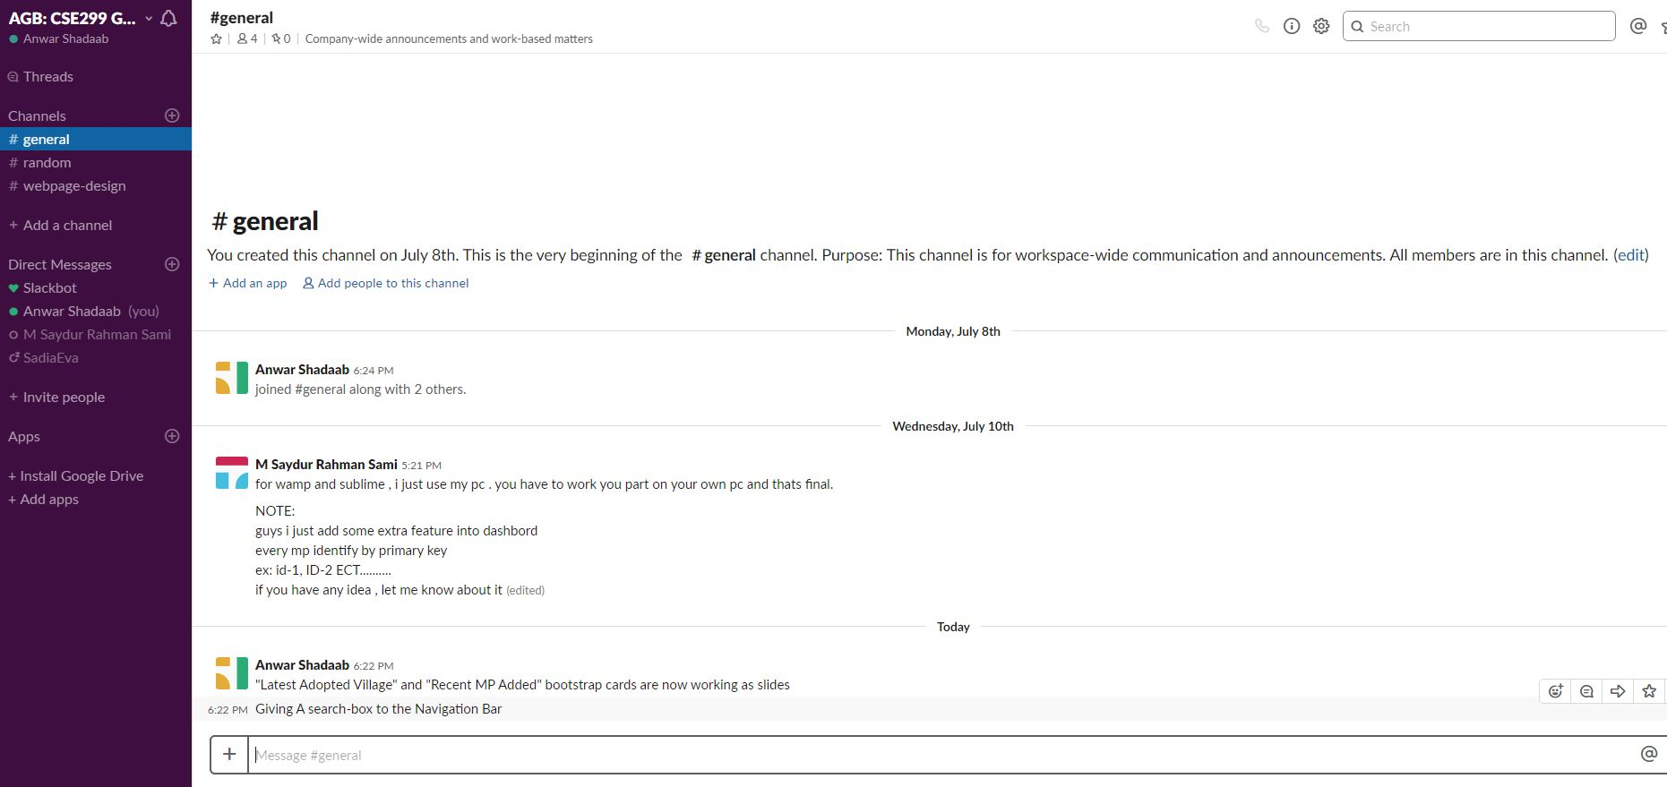
Slack Channel

Slide 11
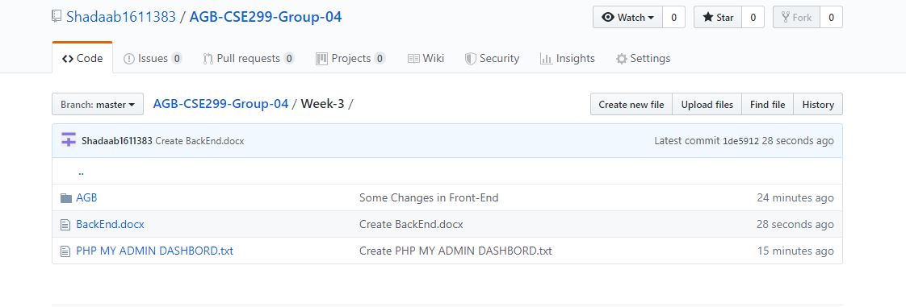
Github

